Slide 1
LIPOSUCTION

Slide 2
LIPOSUCTION
CHANGE IN CONTOUR
PERMANENTLY REMOVES FAT CELLS THAT ARE UNEVENLY DISTRIBUTED.
TO REMOVE LIPOMAS, ANGIOLIPOMAS & GYNAECOMASTIA.

Slide 3
Pre Operative Photo

Slide 4
Lateral View

Slide 5
TUMUSCENT FLUID
Normal saline 1000cc
Distilled water 300cc
Inj. Adrenaline 1 amp
Inj. Hyalase 1 amp
Inj. Triamcinalone 10mg

Slide 6
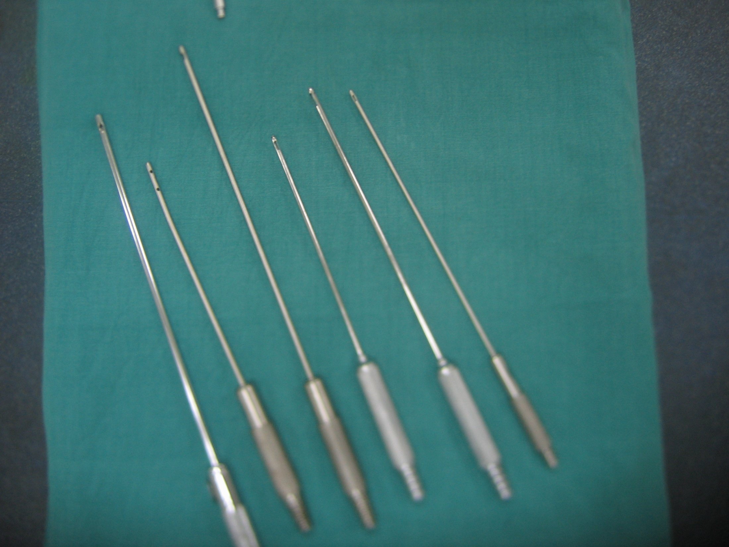

Slide 8
Liposuction Machine

Slide 9
Liposuction followed by Abdomino Plasty

Slide 10
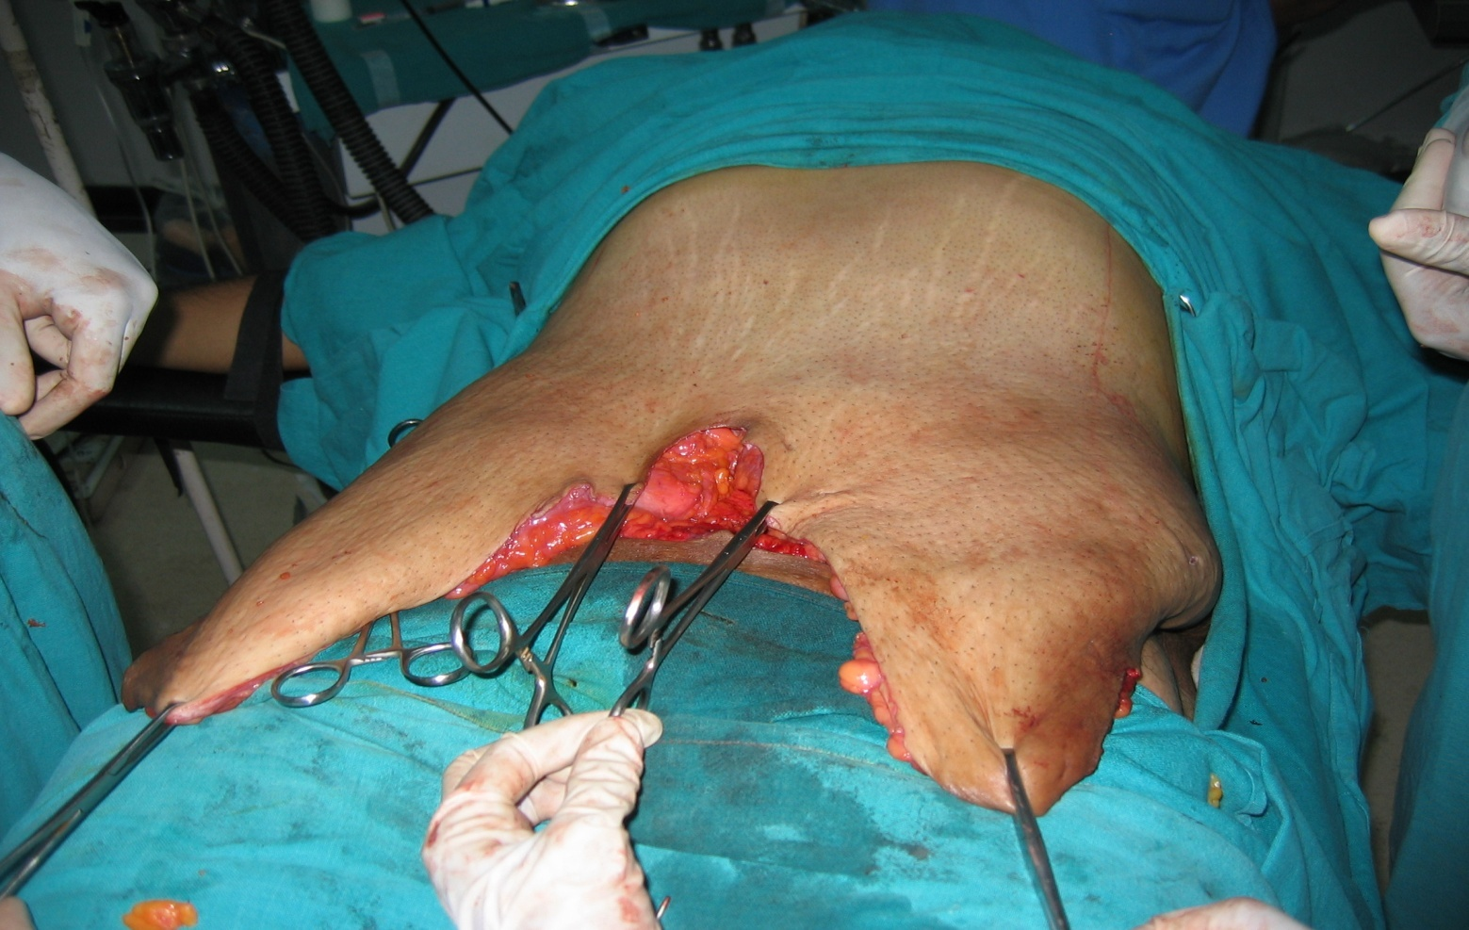
INTRAOPERATIVE VIEW

Slide 11
Post Op Photo on Pressure Garment

Slide 12
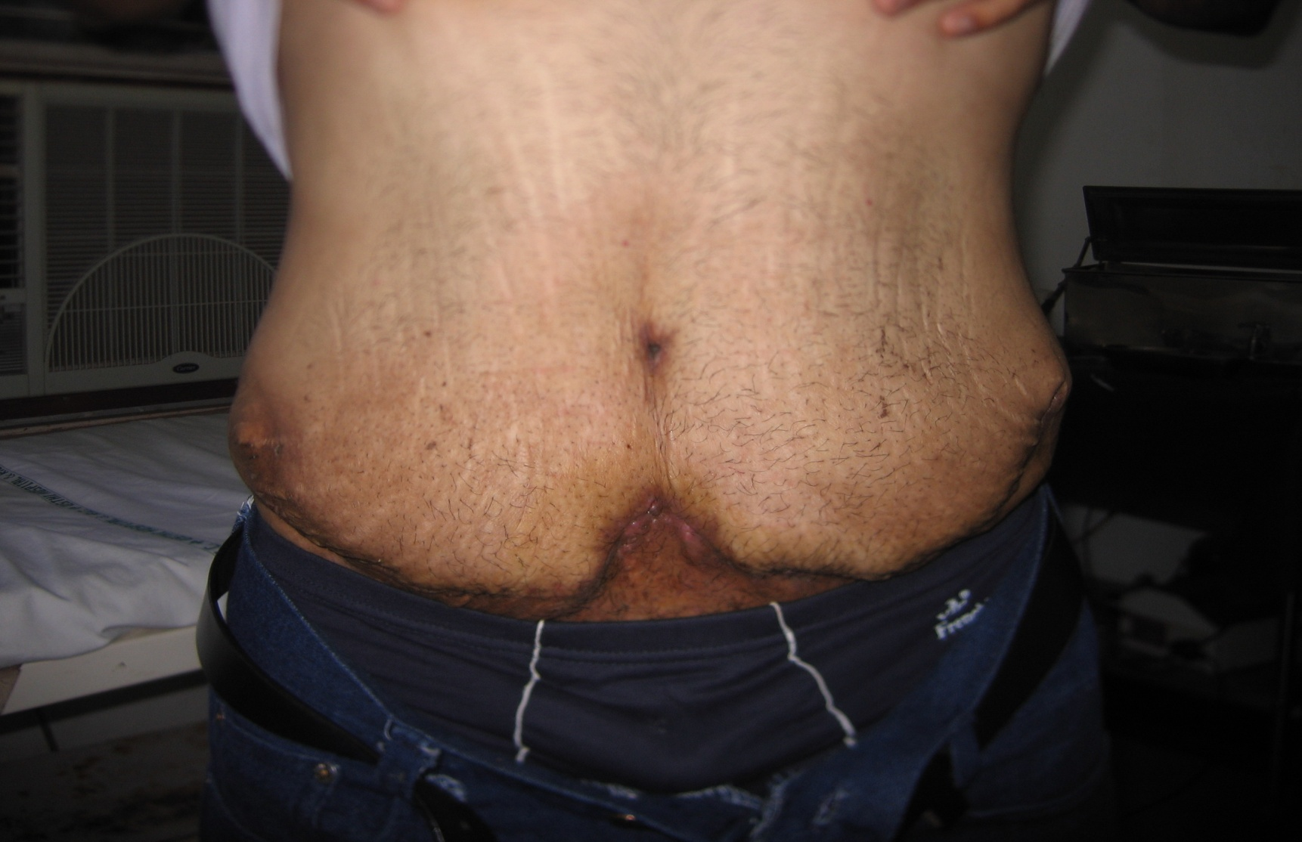
Post Op View

Slide 13
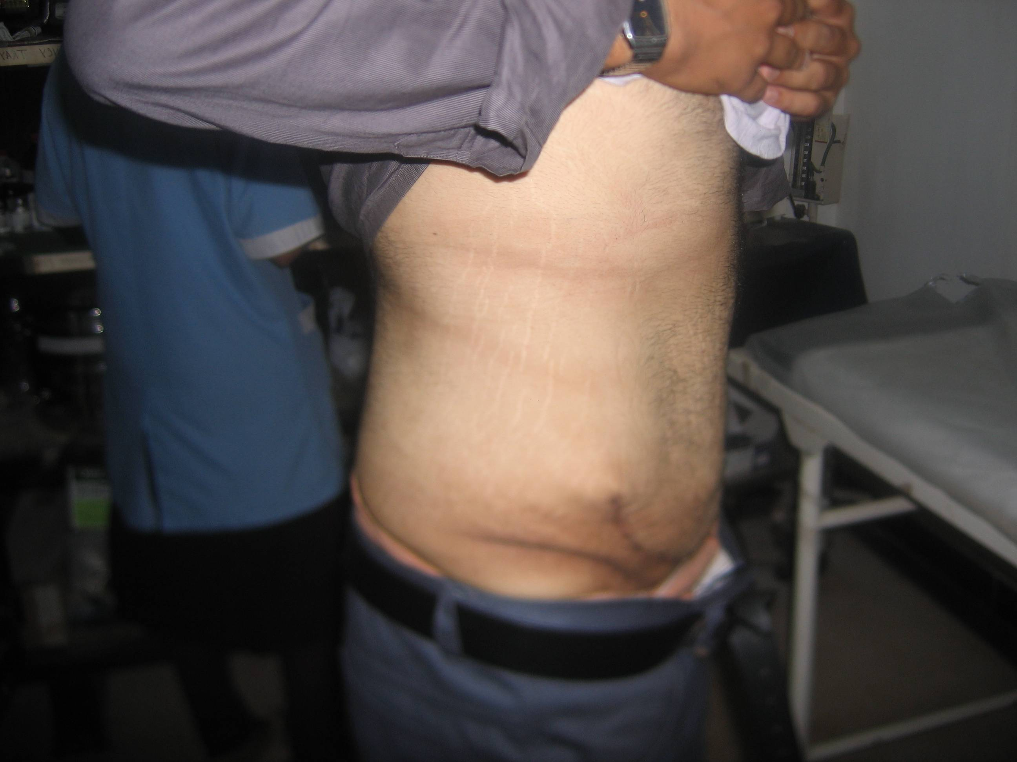
Post Op Lateral View

Slide 14
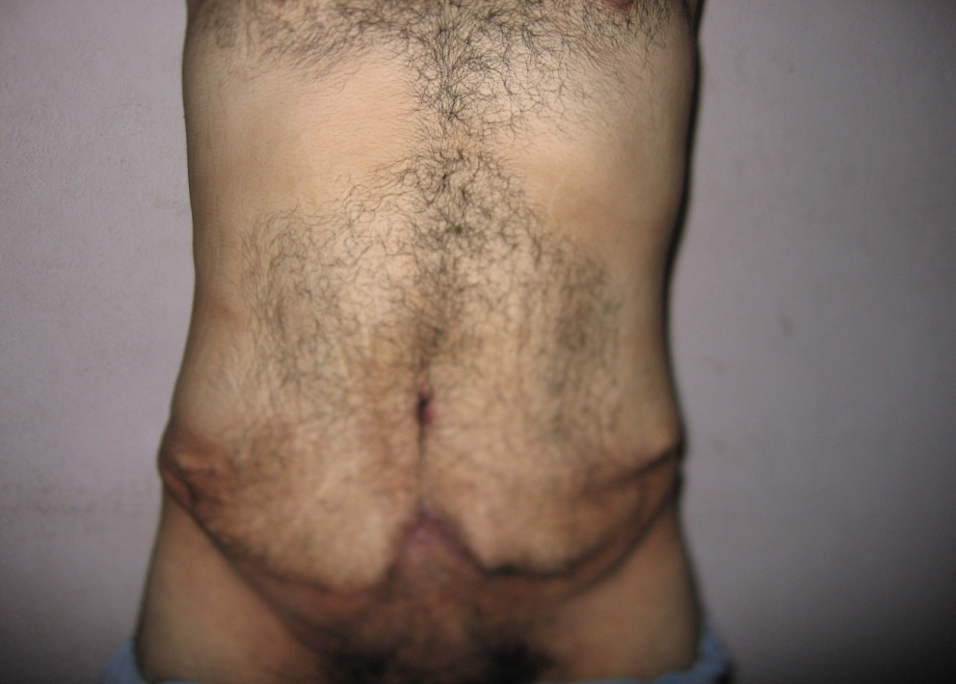
Pre Op Photo
Post Op View

Slide 15
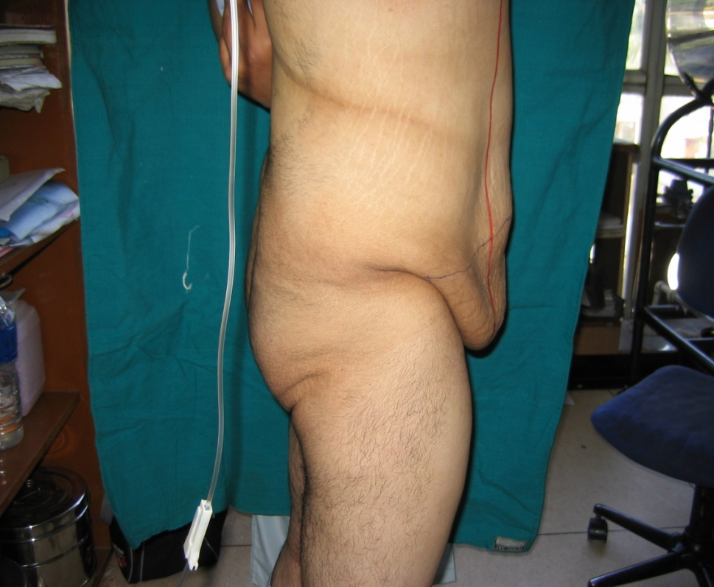
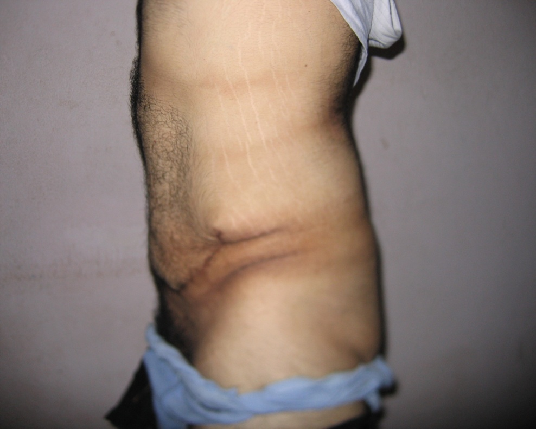
Pre Op Lateral Photo
Post Op Lateral View

Slide 16
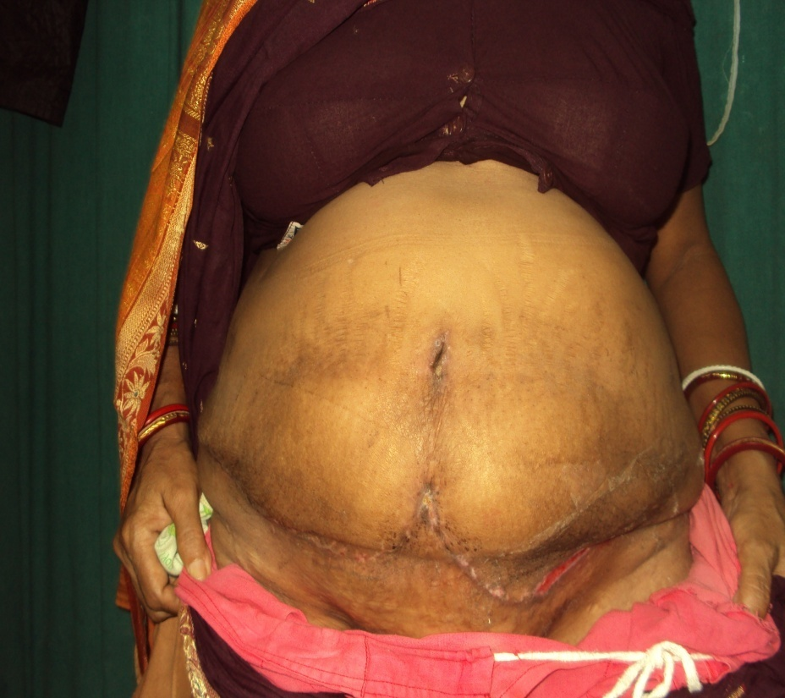

Slide 17
